Slide 1
Practice: Linux and Text Editor (Week 1)

Slide 2
Linux

Slide 3
Unix Operating System
Unix is a computer operating system originally developed in 1969 by a group of AT&T employees at Bell Labs, including Ken Thompson, Dennis Ritchie, Douglas McIlroy, and Joe Ossanna
Unix operating systems are widely used in both servers and workstations
Unix was designed to be portable, multi-tasking and multi-user in a time-sharing configuration

Slide 4
The GNU/Linux Operating System
Linux is a free Unix-like operating system originally created by Linus Torvalds with the assistance of developers around the world
Developed under the GNU General Public License, the source code for Linux is freely available to everyone
Today Linux distributions are used in numerous domains, from embedded systems to supercomputers

Slide 5
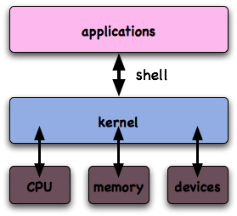
The GNU/Linux Operating System (contd.)
The kernel
The central component of most computer operating systems
Manages the system's resources
The shell
The shell acts as an interface between the user and the kernel
Interprets the commands the user types in and arranges them to be carried out by the computer

Slide 6
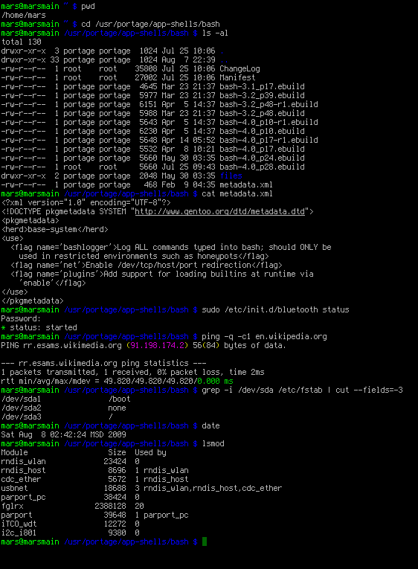
Using the Command Line Interface
Users can login to the system both locally and remotely
Multiple users can simultaneously use the system
A shell program is used to execute commands and run other programs
sh, csh, bash, tcsh

Slide 7
Accessing a Remote Server
Users can access the server via an SSH (Secure Shell) service
Terminal emulators supporting SSH protocol can be used to access remote Linux systems
PuTTy: Open source terminal emulators for Windows
Use an SFTP client to upload/download files to/from the server
FileZilla, WinSCP

Slide 8
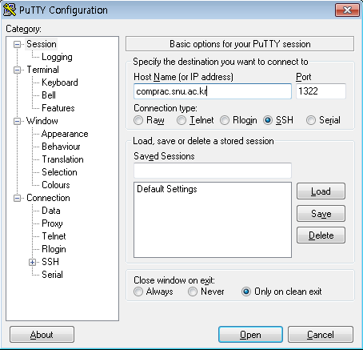
Accessing a Remote Server (contd.)
Open a PuTTy client
Host Name: comprac.snu.ac.kr
Port: 1322
Connection type: SSH
Sessions can be saved with a specified name

Slide 9
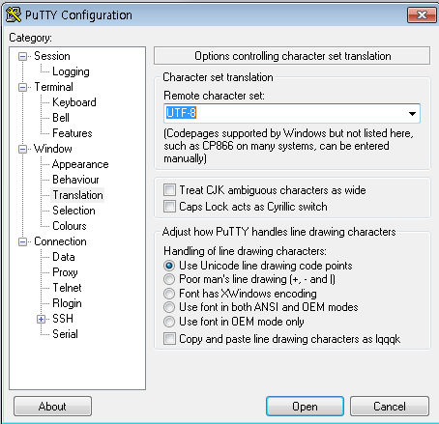
Accessing a Remote Server (contd.)
Translation : UTF-8
한글출력을 위해서 필요한 사항

Slide 10

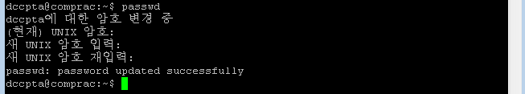
Logging in & Changing Password
Login using your ID
The default shell will be loaded: bash
Change your password immediately : passwd
ID
PASSWORD

Slide 11
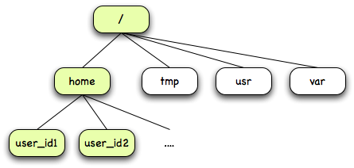
The Directory Structure
All files are grouped together in the directory structure
The top of the directory hierarchy is traditionally called root

Slide 12
Standard Unix Directory Structure
/
Root
boot
Contains the Linux boot image and configuration files
home
Home directories of user accounts
root
Home directory of root account
bin
Contains executable binary files
sbin
Contains executable system binary files
usr
Used for applications and has sub-directories – bin, lib, etc.
etc
Contains configuration files which are local to the machine
lib
Contains shared object library files that are necessary to system
dev
Contains device files required for interfacing with hardware
proc
Provides system information, just a virtual directory
tmp
Used for temporary storage space
mnt
Used for mounting temporary file systems
var
Contains files of variable file storage such as log files, etc.

Slide 13
Current Working Directory
The directory the user is currently working on
cd {dirpath}
Change the current working directory to {dirpath}
If directory is not given, it goes to the home directory
pwd
Show current working directory
Displayed in absolute path

Slide 14
Directory Terminology
Absolute path
A path specified starting from the root
Starts with ‘/’
e.g., “/home/progpract01/dir1/dir2”
Relative path
A path specified starting from the current directory
e.g., “dir1/dir2” or “../pp1/dir1/dir2”
$ pwd
/home/dccp01
$ cd usr
$ pwd
/home/dccp01/usr
$ cd /usr
$ pwd
/usr

Slide 15
Special Directory Symbols
/ - root
~ - user home directory
. - current directory
.. - the parent directory of the current directory
$ cd /
$ pwd
/
$ cd ~
$ pwd
/home/dccp01
$ cd ..
$ pwd
/home

Slide 16
Basic Shell Commands
ls
Show the contents of a directory
-a: Do not hide entries starting with .
-l: Show lots of miscellaneous info
-t: Sort by modification time
mkdir {dir}
Create a directory {dir}
Option ‘-p’ is used to make sub-directories all at once
rmdir {dir}
Delete a directory {dir}
The directory must be empty
In order to remove a directory including its files and sub-directories type “rm –rf {dir}”

Slide 17
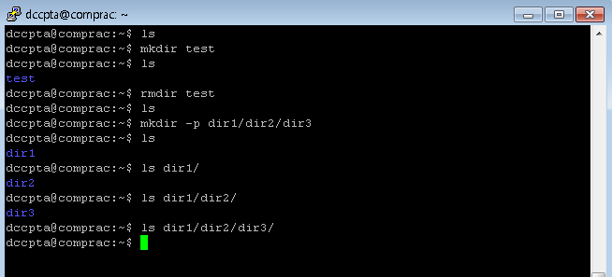
Basic Shell Commands (contd.)

Slide 18
Basic Shell Commands (contd.)
cat {file}
Prints the contents of {file} to standard output
man {command}
Display manual page for a specified command
h: help
DownArraow/Enter/Space/e/f/z: move forward
UpArrow/y/b/w: move backward
q: quit

Slide 19
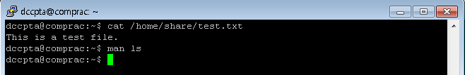
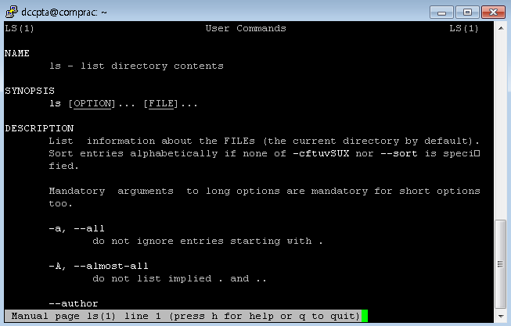
Basic Shell Commands (contd.)

Slide 20
Basic Shell Commands (contd.)
rm {file}
Remove a file
‘-r’ is used to remove files and directories recursively
mv {old} {new}
Rename a file from {old} to {new}
Also works for moving files between directories
If there is already a file named {new}, it is overwritten
cp {old} {new}
Copy one or more files to another location
If there is already a file named {new}, it is overwritten
‘-r’ is used to copy files and directories recursively

Slide 21
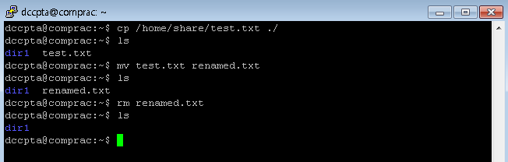
Basic Shell Commands (contd.)

Slide 22
Exercises
Type the following commands and see what happens
$ ls
$ pwd
$ mkdir test1 test2
$ ls
$ cd test1
$ cd ~/test2
( ‘~’ means home directory of user )
$ ls /home/share
$ cp /home/share/test.txt ./
( ‘./’ or ‘.’ means current working directory )
$ cat test.txt
$ rm test.txt
$ rmdir ../test1
(or /home/{user_id}/test1 )

Slide 23
Exercise (contd.)
$ cd ~
( change current working directory to home directory )
$ mkdir –p nested/directory
$ cd nested/directory
$ pwd
$ cd -
( change current working directory to previous working directory )
$ cd /home/{user_id}/nested/directory
$ cp –rf /home/share/cpdir .
( option ‘-rf’ makes all the sub-directories copied )
$ cat cpdir/dir1/sample1.txt cpdir/dir2/sample2.txt
$ cd ../..
$ rmdir nested
( rmdir only works for empty directories )
$ rm –rf nested

Slide 24
Vim Editor

Slide 25
Vim
Vim is a highly configurable text editor built to enable efficient text editing
It is an improved version of the vi editor which is distributed with most UNIX systems
Vim is often called a "programmer's editor“
Many feature sets make it possible to be considered as an IDE (Integrated Development Environment)

Slide 26
Modes in Vim
Vim behaves differently in each different mode
INSERT mode
For text editing
NORMAL mode
For using Vi functions
COMMAND-LINE mode
In normal mode type ‘:’ to input a command
Command-line will appear in the bottom
$ vi filename
NORMAL
mode
<ESC>
<Return>
<ESC>
:
a, i
COMMAND-
LINE
mode
INSERT
mode
:q
:wq
ZZ
$

Slide 27
Vi Quick Start
Start vi editor with “vi {file_name}”
Press “i” and type whatever you want
Press <ESC> key and type “:wq” to save the contents
Type “cat {file_name}”

Slide 28
Frequently Used Commands
Summary of vi commands
h/j/k/l | move cursor one character to left, down, up, right. | dd | delete current line
 |  | u | undo the last command
^f, ^b | scroll forward/backward one screen | yy | copy current line into buffer
i/a | insert to before/after cursor | p/P | paste text in buffer after/before the cursor
I/A | Insert at beginning/end of line | /string | search forward for string
o/O | add new line below/above cusor and insert text | n/N | repeat forward/backward last search
x/X | delete current/previous character | :w | write file to disk
r | replace character on cursor | :q[!] | quit VI [without saving]

Slide 29
Vim Tutorial
Vim editor provides built-in tutorial “vimtutor” for beginners
Type in “vimtutor” to start
You can use “vimtutor {lang}” for a translated version of tutorial
Ex) Type in “vimtutor ko” for Korean

Slide 30
Additional Information
Type “:help” or “:help {subject}” in vim command-line
Free books and manuals available
ftp://ftp.vim.org/pub/vim/doc/book/vimbook-OPL.pdf
GNU Emacs : Another great text editor
http://www.gnu.org/software/emacs/
http://www.gnu.org/software/emacs/tour/: A guided Tour
http://www.gnu.org/software/emacs/manual/html_node/emacs/index.html: Manual
Build-in tutorial: Start Emacs and type “Ctrl-h t” to fire up the tutorial

Slide 31
Exercise
Run vim tutorial and follow the instructions

